Slide 1

School of Computer Science And Engineering Department of Artificial Intelligence
Minor Project Presentation-I
on
Title: HAND GESTURE BASED VOLUME CONTROL
Presented By: Sankalp Dutta , Siddhant Upadhyay , Priyanshu Baliyan
Section:- D
Supervised By: Mr. Surendra Solanki
Designation: Assistant Professor

Slide 2
Agenda/ contents
Introduction
Problem Statements
Requirements Engineering
Design/ Development
Timestamp
References

Slide 3
Introduction
Introducing a cutting-edge endeavor in human-computer interaction, our project pioneers a revolutionary method for volume control utilizing hand tracking models.
By leveraging advanced algorithms capable of tracking thumb and finger movements, we aim to redefine the conventional means of adjusting audio levels.
Gone are the days of fumbling with buttons or dials; instead, users can effortlessly modulate volume with intuitive hand gestures

Slide 4
Problem Statements
Despite the advancements in hand gesture recognition technology, significant challenges persist in achieving robust and accurate recognition across diverse contexts. Lighting conditions, occlusions, and variations in hand poses present formidable obstacles that must be addressed to ensure reliable performance. Furthermore, the integration of real-time processing capabilities and scalability to accommodate a wide range of applications remain ongoing challenges in the field. This project seeks to tackle these issues head-on, leveraging state-of-the-art methodologies to develop a robust hand gesture volume control system capable of operating in real-world environments.

Slide 5
Requirements Engineering
Software:
- Python (programming language) - OpenCV (computer vision library) - Scikit-learn (machine learning library)
Hardware: -
GPU (Graphics Processing Unit) for accelerated training (optional but recommended) - Webcam or video input device for real-time gesture recognition

Slide 6
Design/ Development
SOME METHODOLOGY
Hand Detection and Tracking: - Hand Detection and Tracking: Utilize computer vision techniques to detect and track the user's hand in real-time. This involves selecting appropriate algorithms and frameworks (e.g., OpenCV, Media Pipe) to accurately locate and follow the hand's movements.
Gesture Recognition: Train machine learning models, such as convolutional neural networks or recurrent neural networks to recognize specific hand gestures associated with volume control commands. This involves feeding the preprocessed data into the model and iteratively optimizing its performance.

Slide 7

Testing and Evaluation: - Conduct rigorous testing to assess the accuracy, responsiveness, and reliability of the gesture-controlled volume system. This includes both simulated testing and real-world usage scenarios to identify and address any issues or limitations. - Thorough testing on diverse datasets to assess model generalization and robustness across different scenarios and conditions.
Deployment and Integration: - Integrate the trained model into user-facing applications and platforms, ensuring seamless interaction and compatibility with existing systems. - Solicit feedback from users and stakeholders to identify areas for improveme

Slide 8
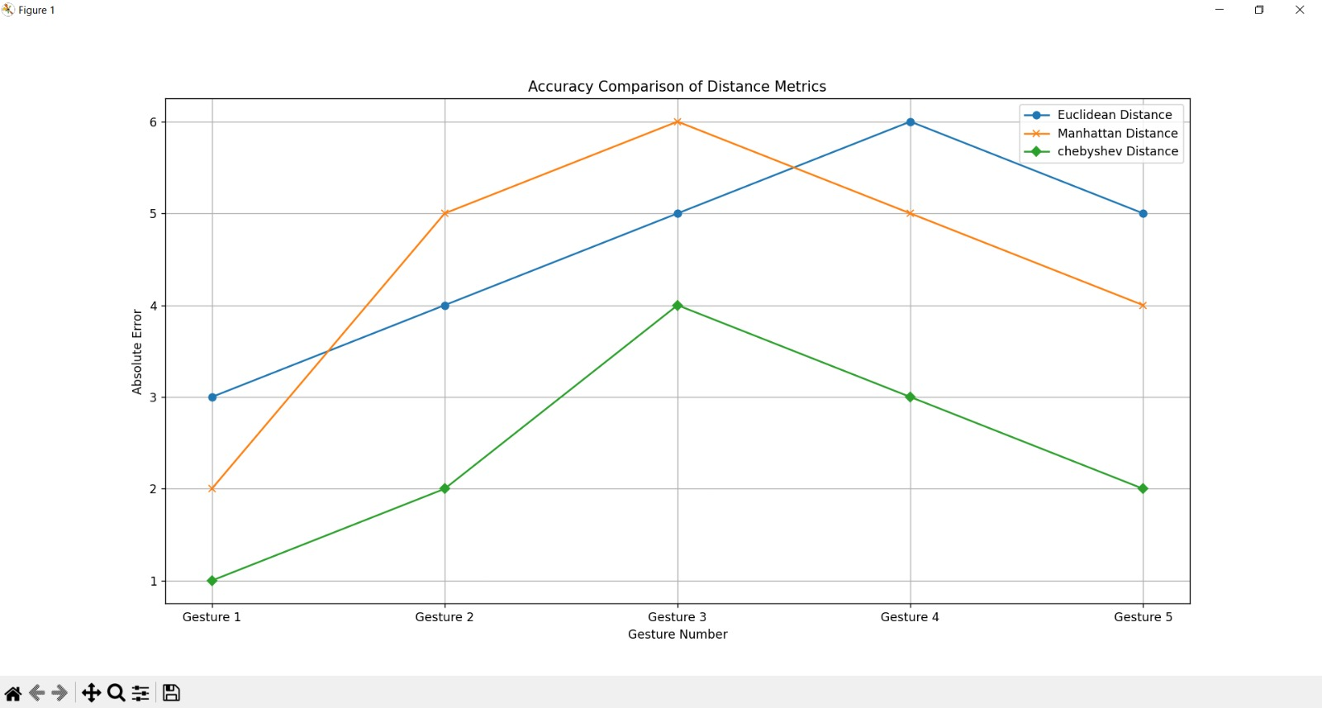
Accuracy metrics

Slide 9
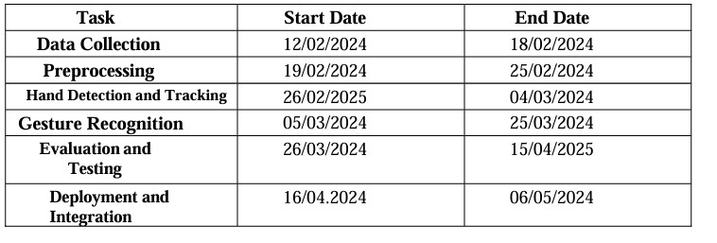
Timeline

Slide 10
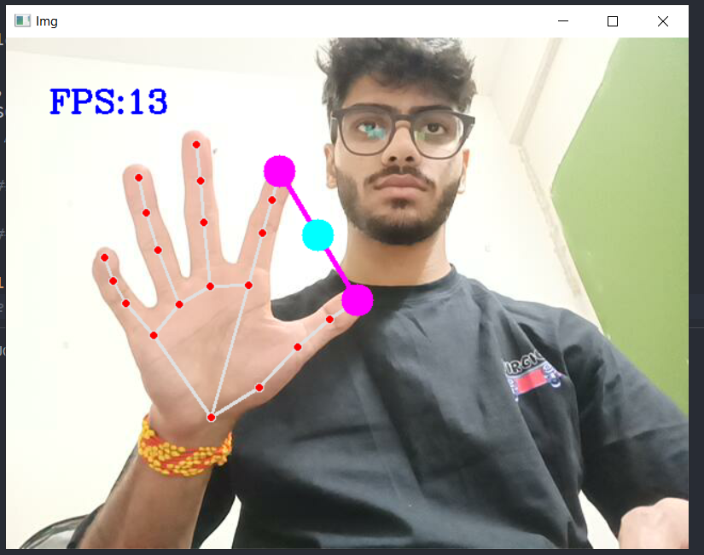
SOME sNIppets

Slide 11
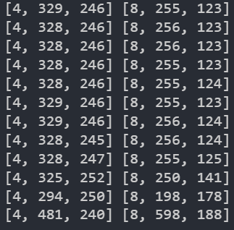
These are the coordinates of the points that
Are marking the hand and kept on changing
While moving our hand

Slide 12
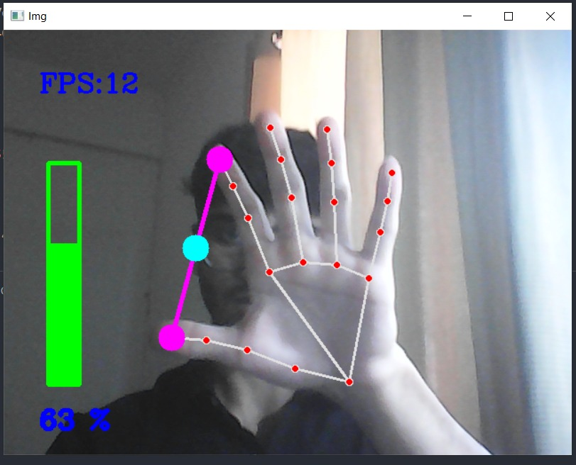
Final outputs
Here the Bar is showing volume of the device or PC that we are using .
More distance between thumb and finger will led to more value of volume and same for the smaller distance .

Slide 13
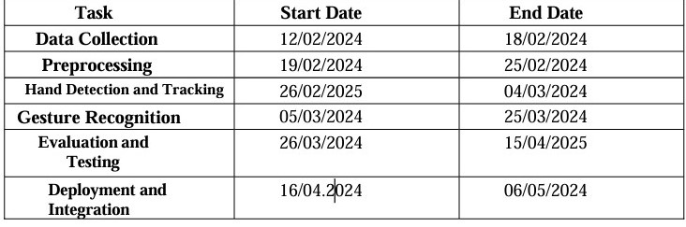
TimeLine of project

Slide 14
references
Li, C. T., & Nixon, M. S. (2004). Hand Gesture Recognition Using Shape Context Matching. Proceedings of the IEEE International Conference on Pattern Recognition.
2. Pu, J., & Black, M. J. (2020). Mocap-guided Data Augmentation for 3D Hand Pose Estimation. Proceedings of the European Conference on Computer Vision (ECCV).
3. Kolsch, H., Turk, A., & Burkhardt, H. (2005). Hand Gesture Recognition Based on Local Features: A Combination of Finger Posing and Movements. Proceedings of the IEEE Workshop on Automatic Identification Advanced Technologies (AutoID).
4. https://www.computervision.zone/courses/gesture-volume-control

Slide 15
Thank You

